Slide 1
Model Quantizations

Slide 2
What is DNN model quantizations?
Reduction of the number of bits (i.e. precision)
Weight to reduce model size
Feature maps to reduce
Gradient to save
To increase throughput while preserving accuracy

Slide 3
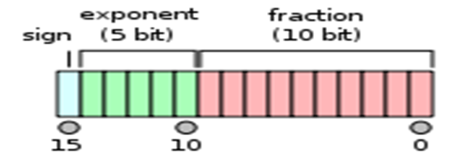
Reduced-precision number of formats
Fixed-point :
32 bits / 16 bits / 8bits / xbits
Ternary :
2 bits
Binary :
1 bits

Slide 4
Possible Benefits of Quantization
Reduction in model size
Reduction in memory bandwidth
Faster inference

Slide 5
Disadvantage of Quantization
Only one disadvantage: Slightly less accuracy
Roughly 2-3 %
Depends greatly on the model
Constraint: Not many hardware devices support low precision computing
Even if low precisions are not supported yet, you can run inference with the quantized models, but you don‘t see any speed up

Slide 6
Why is 8-bit Quantization so Famous?
Because it is the smallest format which is supported by mainstream hardware devices
Lower bit numbers have a strong drop in accuracy
Typically when it is talked about quantization, they mean int8

Slide 7
Quantization approaches
Quantization of pre-trained high-precision models (with fine tune )
Fast and only small dataset is required
Accuracy loss can be reduced by fine-tuning
Quantization-aware training
Slow and need large dataset is required
Quantization of training procedure
Popular for making training procedure more efficient
Ex: training on FPGAs

Slide 8
Example Quantization Tools
TensorFlow Lite supports quantization to float16 and int8
PyTorch
With an Intel Quantization tool
Onnx Runtime

Slide 9
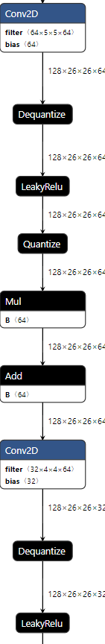
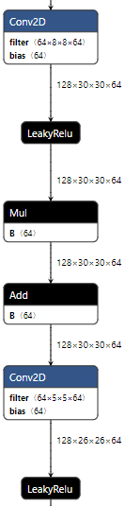
Quantized Custom Model
Quantized graph

Slide 10
Quantized ResNet18 Model
Link : https://pytorch.org/docs/stable/quantization.html
PyTorch Static Quantization | PyTorch-Quantization-Aware-Training | PyTorch Dynamic Quantization
FP32 evaluation accuracy: 0.869 INT8 evaluation accuracy: 0.868 FP32 CPU Inference Latency: 4.68 ms / sample FP32 CUDA Inference Latency: 3.70 ms / sample INT8 CPU Inference Latency: 2.03 ms / sample INT8 JIT CPU Inference Latency: 0.45 ms / sample | FP32 evaluation accuracy: 0.869 INT8 evaluation accuracy: 0.867 FP32 CPU Inference Latency: 4.36 ms / sample FP32 CUDA Inference Latency: 3.55 ms / sample INT8 CPU Inference Latency: 1.85 ms / sample INT8 JIT CPU Inference Latency: 0.41 ms / sample | FP32 Model Size: 411.00 MB INT8 Model Size: 168.05 MB CPU Inference Latency: 52.27 ms / sample Dynamic Quantized CPU Inference Latency: 40.63 ms / sample CUDA Inference Latency: 7.02 ms / sample

Slide 11
ThankYou

